Slide 1
Lesson 3 – Clouds in the Sky (Condensation)
Farming & Our Food - A Grade 2 Water Cycle Unit
This lesson was created by Grain Farmers of Ontario to be used by Ontario educators in the classrooms. For any questions or concerns regarding use please contact bcurtis@gfo.ca

Slide 2
These lessons are designed to empower you in leading engaging, hands-on STEAM activities that directly connect with the Ontario Science curriculum. We understand that every classroom is unique, so each lesson offers a variety of options for implementation. Choose the approach that best suits your students and learning environment.
Notes:
Educator Notes:
This is the third lesson in the unit, building on the understanding of water's states and evaporation.
The focus is on condensation and how clouds form, directly linking to the source of precipitation for grain farms.

Slide 3
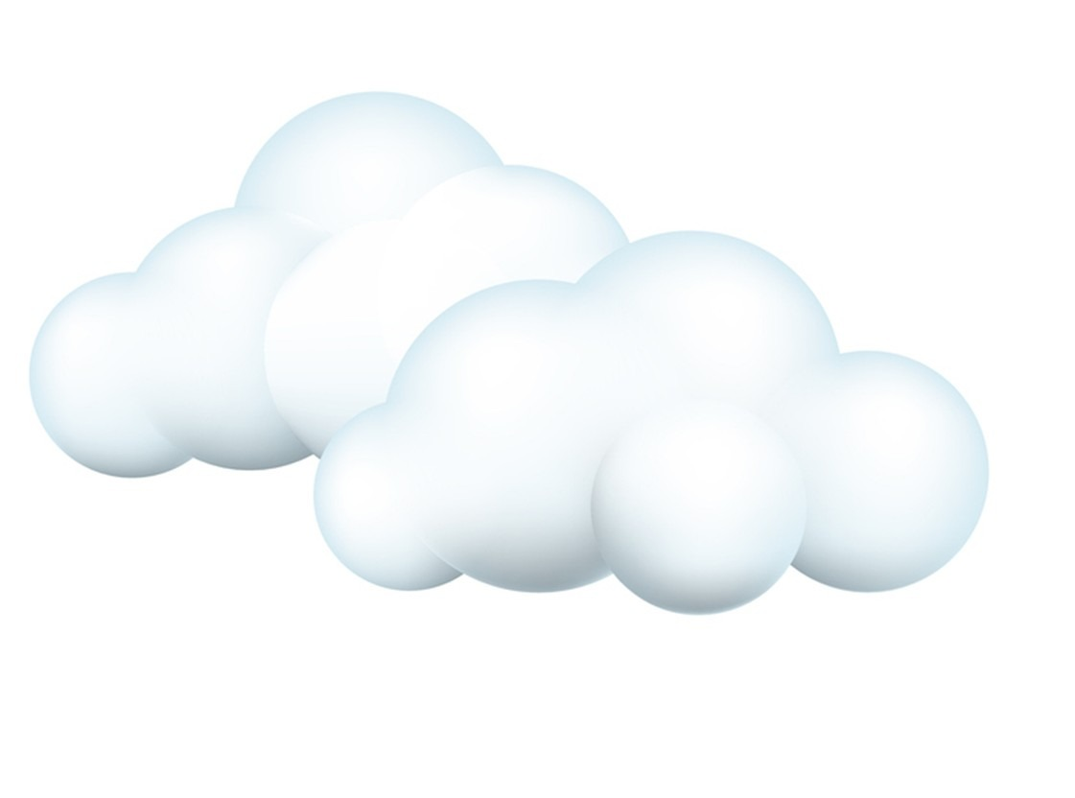
Lesson Overview
What We'll Explore: How Clouds Are Made!
Learning Goal:
Students will be able to explain condensation as water vapour cooling and changing back into tiny liquid water droplets, forming clouds.
Curriculum Connections:
Overall: E2. demonstrate an understanding of the properties of air and water, including water in various states, and of ways in which living things depend on air and water for their survival.
Specific: E2.3 describe the stages of the water cycle, including evaporation, condensation, precipitation, and collection.
Key Concepts:
Condensation
Water Vapour (gas)
Clouds
Importance of clouds for rain-fed farming
Notes:
Educator Notes:
Clearly state the learning objective for students.
Highlight the specific curriculum expectations covered in this lesson.
Emphasize that condensation is the opposite of evaporation.
Reinforce the critical role clouds play in the water cycle for agriculture.
Note: Rain-fed farming refers to farming that relies on natural rainfall for water, without using any irrigation (using artificial means of watering like canals, pumps or sprinklers). The majority of Ontario’s grain crops are grown without irrigation.

Slide 4
Materials & Activity
Getting Ready: Materials & Your Choices
General Materials Needed:
Chart paper or Whiteboard, markers
The following slides
Option 1: Common Materials - Student-Led Cloud in a Jar
Focus: Creating a small, observable cloud model.
Additional Materials: Clear glass jars with lids (one per small group), hot water (adult supervised), ice cubes (enough for each group), small plates or aluminum foil (to hold ice on top of jars, one per group), flashlight (optional, for better viewing).
Option 2: Slightly More Complex - Creating a Large Condensation Chamber (Collaborative)
Focus: Building a larger, more impactful cloud model for whole-class observation.
Additional Materials: Large clear plastic bin with lid (one per classroom or large group), hot water (adult supervised), ice packs or a bag of ice, hairspray or matches (optional to further demonstrate clouds)
Notes:
Educator Notes:
Educators - choose the option that best suits your classroom resources and student needs.
A friendly reminder that adult supervision is required for handling hot water in both options, as well as the possible use of a match in the third option
For Option 1, ensure jars are clear for best visibility.
For Option 2, is a more collaborative and larger scale demonstration of clouds.

Slide 5
Minds On
Notes:
(10-15 minutes)
Educator Notes:
Purpose: To engage students with a relatable phenomenon and connect it to the scientific concept of condensation.
Tips: Encourage predictions and discussion. Use simple analogies to explain water vapour turning back into liquid (e.g., like breath on a cold window).
Farming Link: Directly link cloud formation to the source of rain, which is essential for rain-fed grain farming.

Slide 6

Where did this water come from?
Did the glass leak?
Notes:
Educators Notes:
Show the picture of a cold drink on a hot day with water droplets on the outside of the glass. Ask: "Where did this water come from? Did the glass leak?" (Lead them to understand it came from the air).

Slide 7
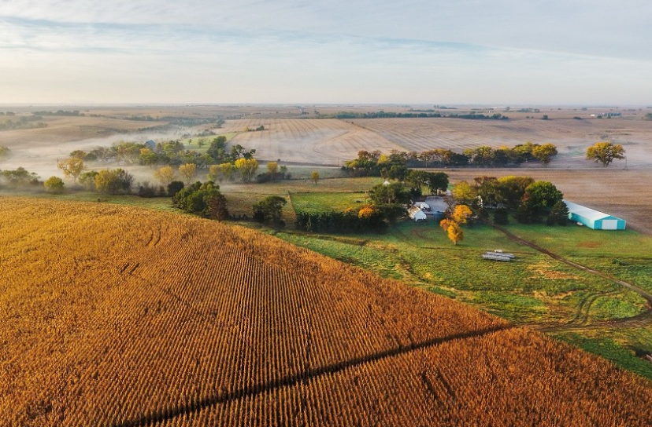
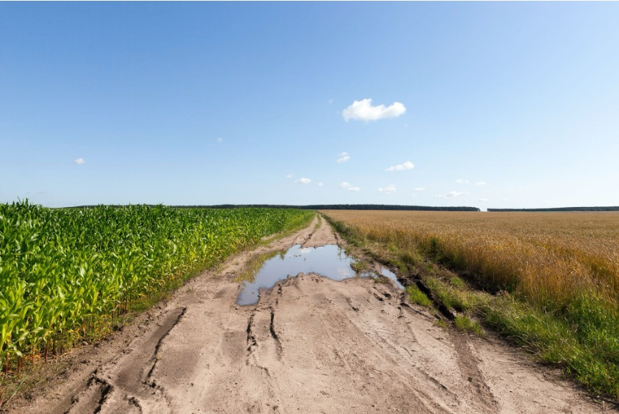
Do you remember the water that evaporated from the puddles and fields and went up into the air as invisible water vapour? What do you think happened to that water vapour?
Notes:
Educators notes:
Recall Evaporation: "In our lesson 2, water evaporated from puddles and fields and went up into the air as invisible water vapour. What do you think happens to that water vapour high up in the sky?
Introduce Condensation: Explain that high in the sky, the air is much colder. When water vapour gets cold, it changes back into tiny liquid water droplets. This process is called "condensation." These tiny droplets clump together to form clouds!

Slide 8

What is Evaporation?
Notes:
Educator notes:
This video is edited to focus only on the condensation portion of the water cycle.
Video source from: https://www.youtube.com/watch?v=TD3XSIE4ymo

Slide 9
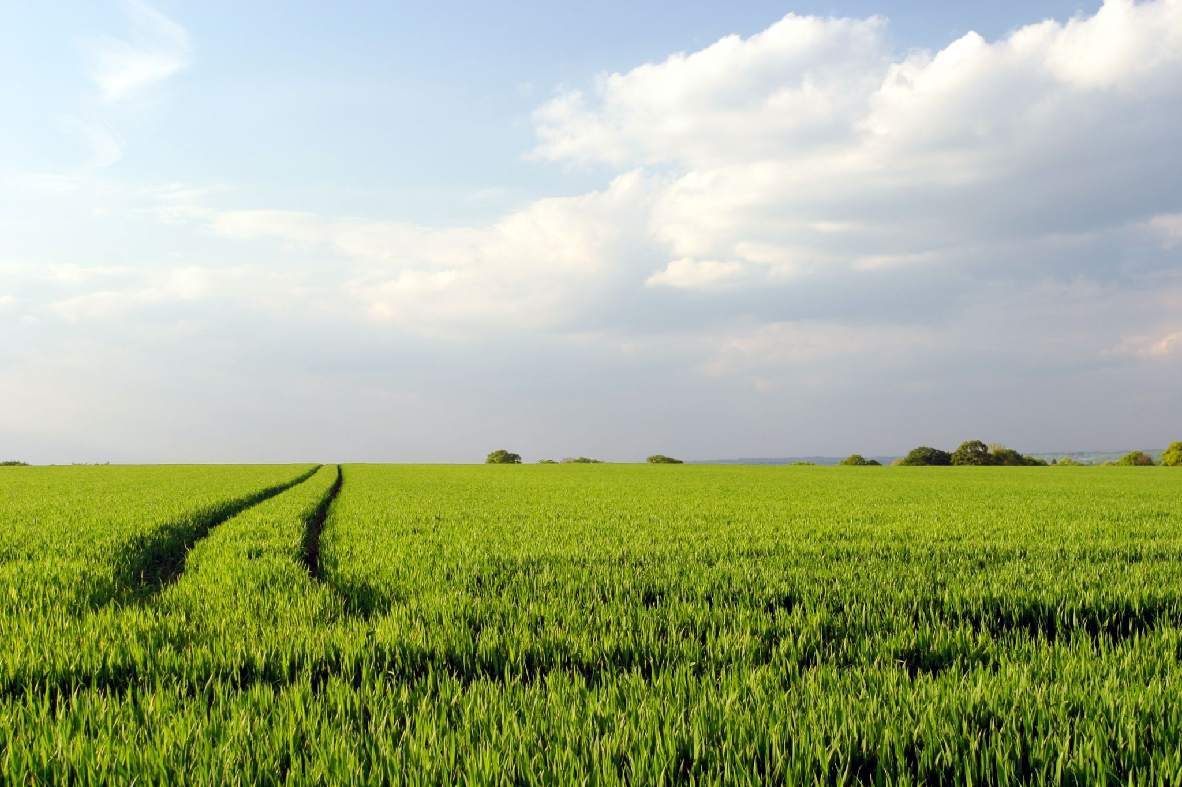
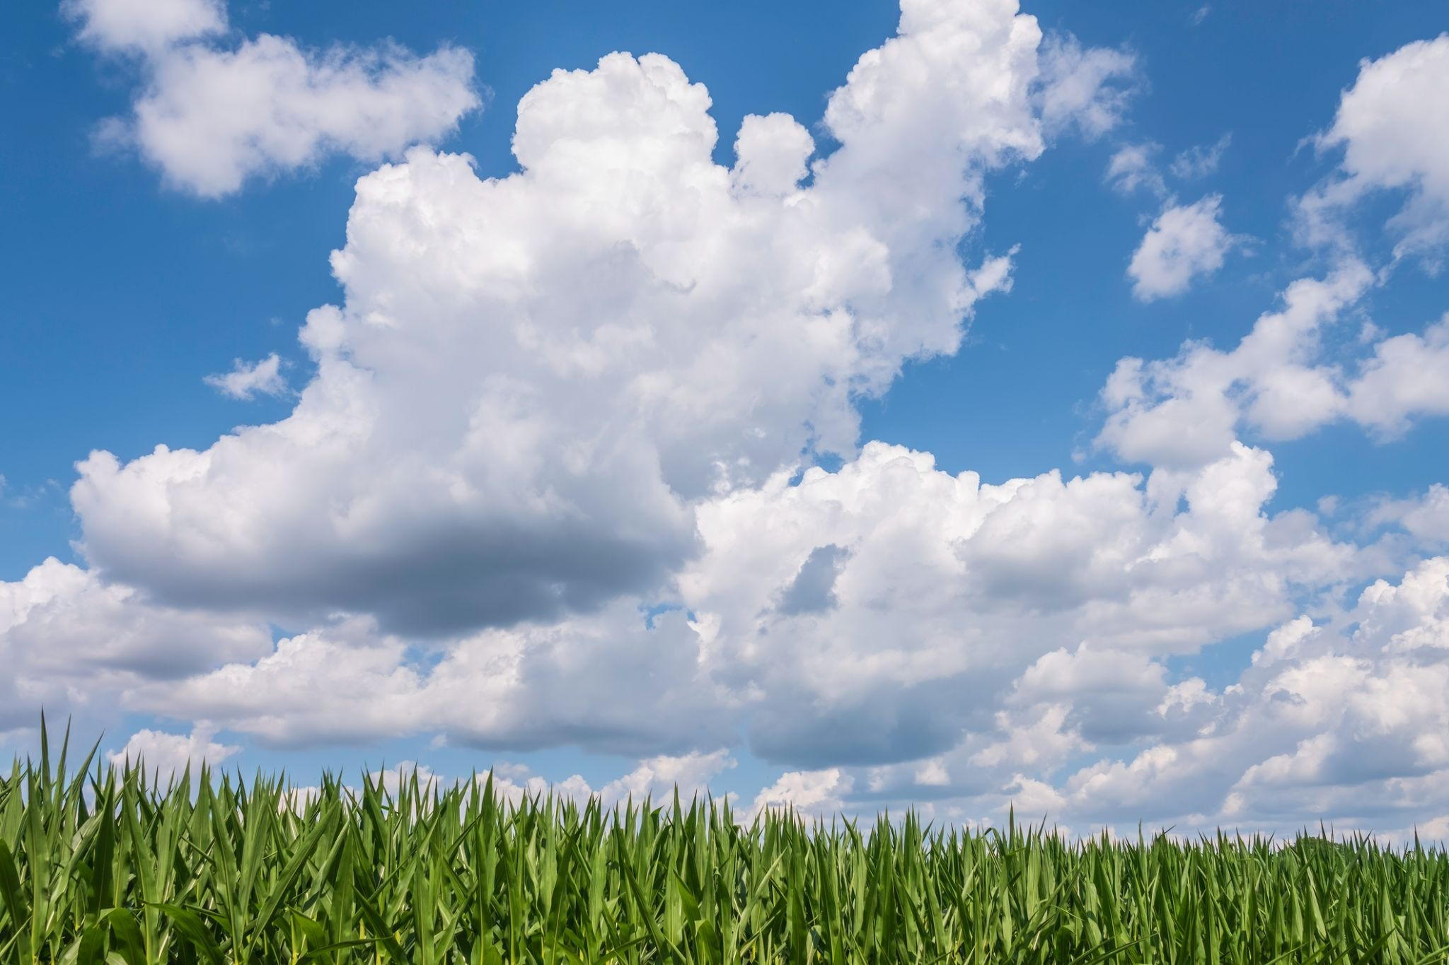
Why are clouds important for grain farmers?
What do they hope comes from the clouds?
Notes:
Educator notes:
Farming Connection: Ask: "Why are clouds important for grain farmers? What do they hope comes from the clouds?" (They hold the water that will eventually fall as rain for their crops).
Some information to share: Why are clouds important for grain farmers?
Clouds are incredibly important for grain farmers because they are essentially the storage tanks for the water that their crops need to grow. While the clouds themselves aren't directly providing the water at that moment, they hold the moisture that will eventually fall as rain. Without this rain, grain crops like barley, corn, oats, soybeans and wheat wouldn't have enough water to thrive, leading to poor harvests or even crop failure.
What do they hope comes from the clouds?
Grain farmers hope for rain to come from the clouds. They want gentle, consistent rain that soaks into the ground, providing the necessary hydration for their plants to grow strong and produce good yields (amount that is harvested). Too little rain (drought) is disastrous, and too much rain (flooding) can also be harmful, so a balanced amount is key.
Sources:
https://goodineverygrain.ca/2020/07/07/ontario-grains-need-a-drink/
https://ontariograinfarmer.ca/2021/03/01/managing-the-weather/#:~:text=UTILIZING%20DATA,depending%20on%20the%20growth%20stage.

Slide 10
Action

Slide 11
Option 1:
Student Led Cloud in a Jar
Notes:
(20-25 minutes)
Educator Notes:
Scaffolding: Provide clear, step-by-step instructions for the experiment by following the slides. Guide students to observe closely and describe what they see.
Safety: Reiterate strict safety for handling hot water. Ensure students to understand not to touch the hot jar directly.
Farming Connection: Make the analogy between the jar cloud and real clouds explicit, emphasizing their role in providing water for grain crops.
Trusted Resources for Cloud Formation and Farming:
Farm & Food Care Ontario - The Real Dirt on Farming: Provides general context on Canadian agriculture and the importance of weather. (Source: https://www.realdirtonfarming.ca/)
Grain Farmers of Ontario / Good in Every Grain - "Sustainability on the Farm": Discusses rain-fed agriculture, reinforcing the reliance on natural precipitation. (Source: https://gfo.ca/market-development-and-sustainability/sustainability-on-the-farm/)
Ontario.ca (Ministry of Agriculture, Food and Agribusiness) - "Water management in agriculture": General information on water management practices in Ontario agriculture, which implicitly relies on understanding precipitation sources. (Source: https://www.ontario.ca/page/water-management-agriculture)

Slide 12
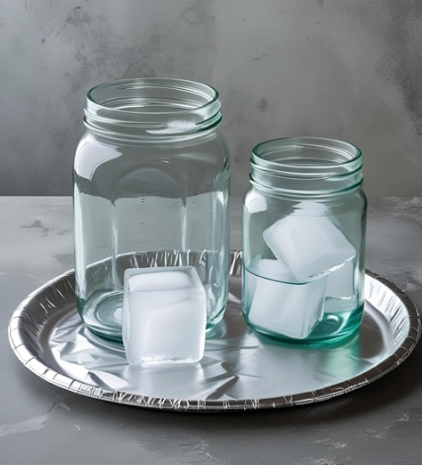
1. Let’s Make A Cloud!
Check for your materials:
Jar
Small foil plate
Ice cubes
Hot water (provided by teacher)
Once hot water is in your jar, swirl water around the sides of jar - Carefully.
Notes:
Educator Notes:
Cloud in a Jar Experiment (Small Groups): Divide students into small groups. Provide each group with a clear glass jar with a lid, a small plate/foil, and ice cubes.
(Adult supervised) Pour about 2 inches of hot water into each group's jar. Have students swirl it around to warm the sides.

Slide 13
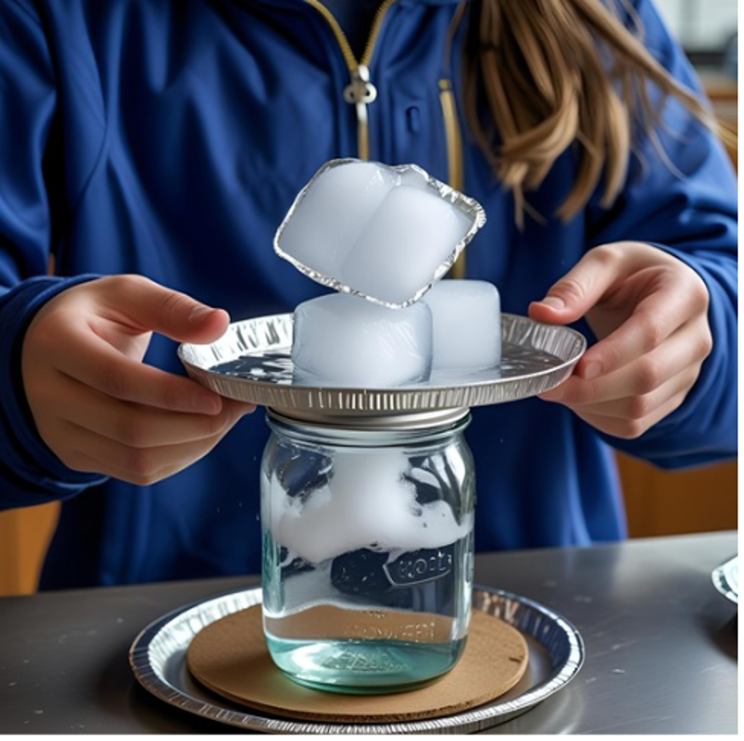
2. Let’s Observe
our Cloud
Place the foil plate on top of your jar.
Place the ice cubes on the plate.
Turn off the lights and shine a flashlight on the jar. Can you see the clouds??
Notes:
Educator Notes:
Students then place the small plate or foil on top of their jar, and put several ice cubes on the plate.
Have students observe what happens inside their jar (a "cloud" will form). They can use a flashlight to see it better (if available).
Explain: The hot water creates water vapour (evaporation). The cold plate cools the air inside the jar, causing the water vapour to condense back into tiny water droplets, forming a cloud.
Discuss Cloud Formation: Talk about how real clouds form in the sky when warm, moist air rises, cools, and condenses around tiny dust particles.

Slide 14

3. Farming Connection:
Real clouds form high above grain farms.
These clouds are like big water tanks in the sky, holding the water that farmers hope will fall as rain to help their crops grow big and strong!
Notes:
Educator Notes:
Farming Connection: Just like the cloud in our jar, real clouds form high above grain farms. These clouds are like big water tanks in the sky, holding the water that farmers hope will fall as rain to help their crops grow big and strong!

Slide 15
Option 2:
Creating a Large Condensation Chamber
Notes:
Educator Notes:
(20-25 minutes)
Educator Notes:
Scaffolding: Ensure all students have a good vantage point to observe the condensation. Encourage them to describe what they see.
Safety: Emphasize strict safety protocols when using hot water or any optional elements like hairspray/matches.
Farming Connection: This larger demonstration helps students visualize how clouds form on a grander scale, directly connecting to weather patterns that bring rain to Ontario's vast grain fields. Reinforce that farmers are keen observers of these natural processes.anadianfoodfocus.org/on-the-farm/water-the-most-precious-on-farm-natural-resource/)
Ontario.ca (Ministry of Agriculture, Food and Agribusiness) - "Water management in agriculture": General information on water management practices in Ontario agriculture. (Source: https://www.ontario.ca/page/water-management-agriculture)

Slide 16
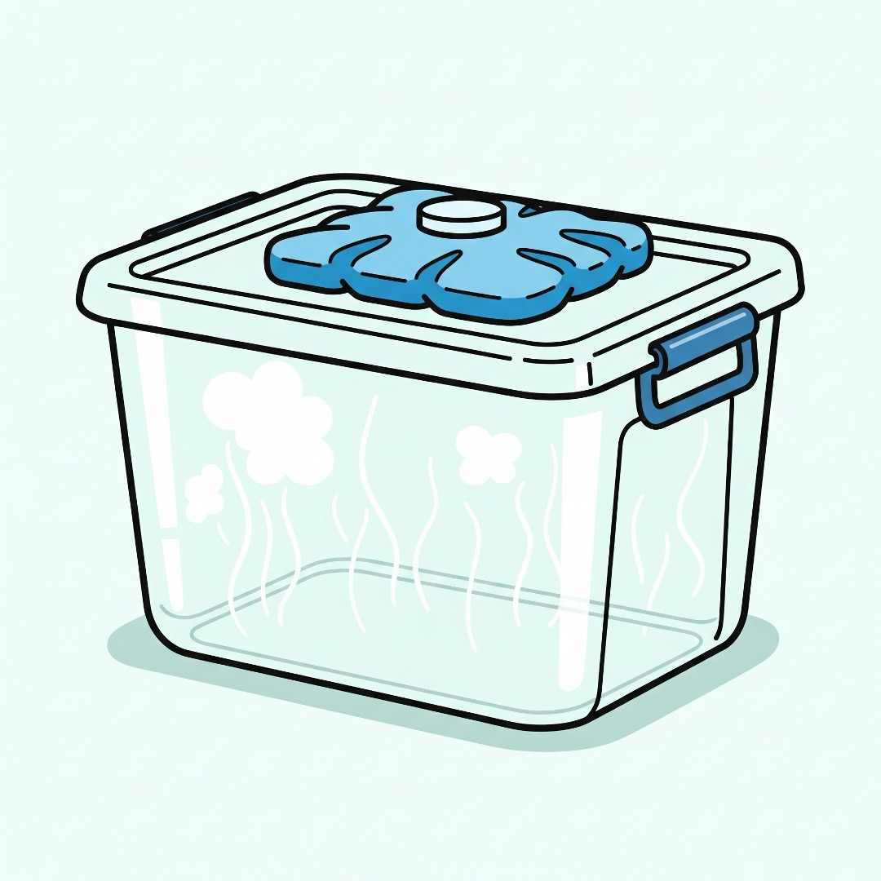
Let’s Begin Our
Soil Experiment
What You Need!
A big, clear plastic bin (with a lid!)
Hot water (grown-up job!)
A big ice pack OR a bag of ice
Your super scientist eyes
Hairspray or match (optional)
Notes:
Educator Notes:
(Adult supervised) Pour about 2-3 inches of hot water into the bin.

Slide 17
Warm Up Our
Cloud Home!
Educators will carefully pour about 2-3 inches of hot water into the bottom of the big clear bin.
Why? The warm water will make our cloud!
Notes:
Educator Notes:
(Adult supervised) Pour about 2-3 inches of hot water into the bin.

Slide 18
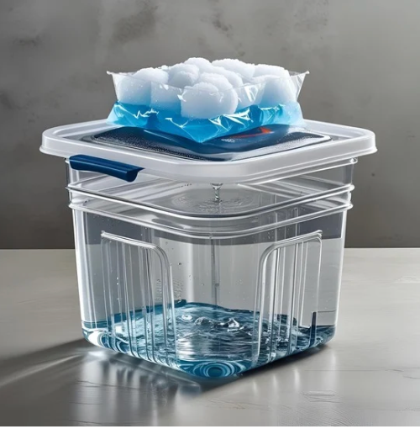
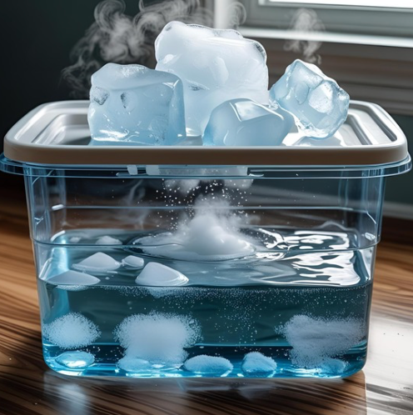
2. Make It Cold on Top!
Students can help place the big ice pack
(or bag of ice) right on top of the lid.
Educators will quickly put the lid on the bin.
Why? The cold lid will help the warm water turn into a cloud!
Watch our cloud grow:
Look closely! Can you see tiny "fog" or "sweat" forming inside the bin?
That's our cloud! It's called condensation
Notes:
Educator Notes:
Have students help place a large ice pack or a bag of ice on the lid, and then quickly place the lid on the bin.
Students can gather around to observe the condensation forming on the inside of the lid and sides of the bin.
*Note: Images created using Canva AI Image Generator - 2nd image with cloud is for demonstration; actual results may vary.

Slide 19
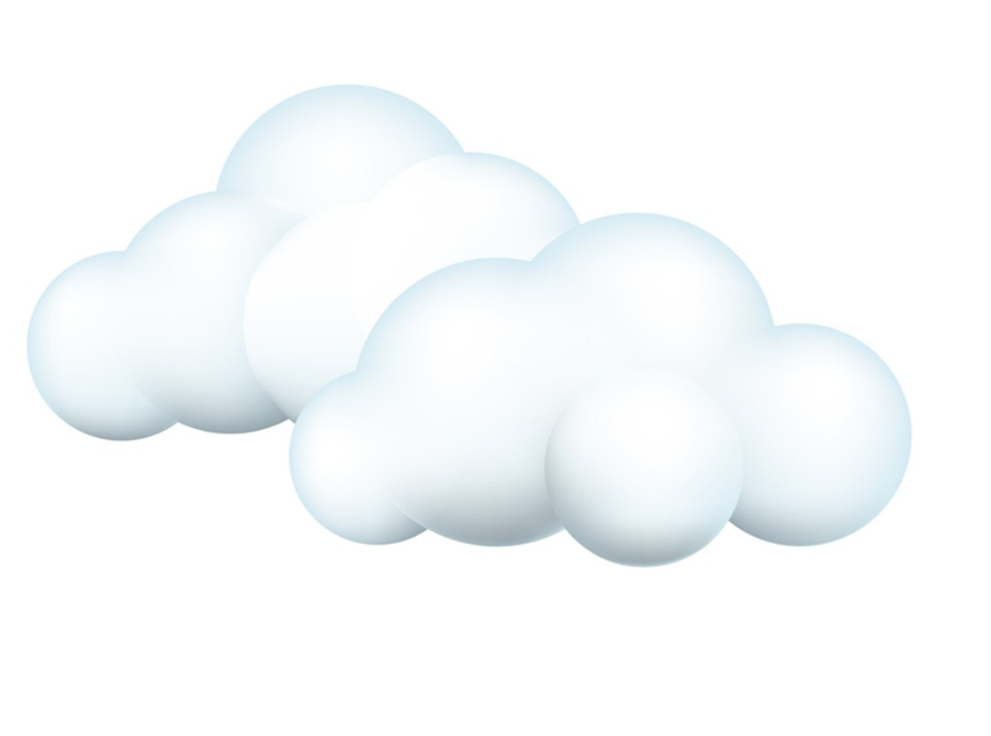


3. Make the Cloud EVEN Bigger! (optional)
(Grown-up only!): Your teacher can quickly lift the lid and quickly light and blow out a match.
Or a student could spray a tiny puff of hairspray
Then, quickly put the lid back on!
Look! Did our cloud get bigger?
Talk about it: Real clouds use tiny bits of dust in the air to help them form
Notes:
Educator Notes:
These are optional steps to show how the cloud could get even bigger.
Optional #1: Adult only: Introduce a smoldering match (adult supervised, quickly extinguish) and replace the lid .
Optional #2: A student could lift the lid, spray a tiny puff of hairspray, and quickly put the lid back on.
Both options provide condensation nuclei, often making the cloud more visible. Ask students, did either of these make the cloud bigger? Talk about how real clouds use tiny bits of dust in the air to help them form.

Slide 20
Connect to Farming
Notes:
This connection can be done after completing Action Option 1 or Option 2

Slide 21

Connect to Farming
Grain farmers are like weather detectives! They watch the clouds very carefully. If they see dark, heavy clouds, they get excited because it often means rain is coming!
Why is rain so important for grain farmers?
Notes:
Educator notes:
Our big class cloud or small group clouds in our jars shows us how lots of invisible water vapour can turn into a cloud in the sky!
Just like we made a cloud, real clouds form high above.
Why is rain so important for grain farmers? Take student answers and guide them to: Because their grain crops (like barley, corn, oats, soybeans and wheat) need that water to grow big and healthy!
Some trusted resources:
Farm & Food Care Ontario - The Real Dirt on Farming: This resource provides a general overview of Canadian farming, including the critical role of weather and precipitation for crop growth. (Source: https://www.realdirtonfarming.ca/)
Grain Farmers of Ontario / Good in Every Grain - "Sustainability on the Farm": This resource specifically highlights that most Ontario grain farming is "rain-fed," directly emphasizing the reliance on natural precipitation (rain from clouds) for growing crops like corn, wheat, and soybeans. (Source: https://gfo.ca/market-development-and-sustainability/sustainability-on-the-farm/)
Ontario.ca (Ministry of Agriculture, Food and Agribusiness) - "Water management in agriculture": While not directly about cloud watching, this resource underscores the importance of water for agriculture in Ontario, implicitly linking to the necessity of precipitation from clouds. (Source: https://www.ontario.ca/page/water-management-agriculture)

Slide 22
Consolidation
Notes:
Educator Notes:
Purpose: To review key concepts and assess student understanding of condensation role in the water cycle and farming.
Assessment: The Lesson 3 exit ticket (can be downloaded from https://goodineverygrain.ca/2026/01/06/water-on-farms-a-six-lesson-unit-for-grade-2/ ) serves as a formative assessment. Look for correct labeling and clear representation of condensation in a farm context.
Differentiation: For students who need more support, provide sentence starters for their explanation. For advanced learners, ask them to describe what might happen if there were no dust particles in the air for condensation.

Slide 23

Let’s Review What We’ve Learned
Notes:
Video resource: https://www.youtube.com/watch?v=vD-ZwMjRDPU - this video has been edited to focus only on the condensation portion of this video within the slides, should you wish to watch the whole video, click on the link

Slide 24
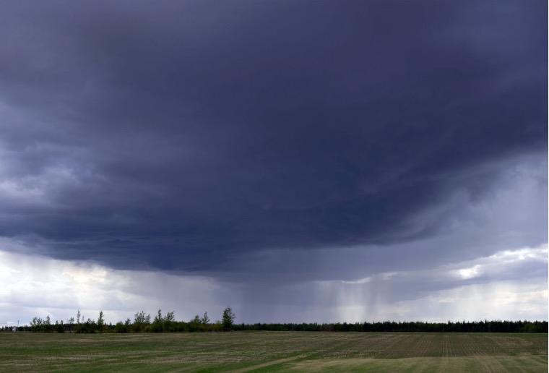
Condensation and Farming
We learned that clouds form from condensation. Imagine you are a grain farmer looking at the sky.
What kind of clouds would make you happy?
What kind would make you worried?
Why?
Notes:
Educator notes:
Possible student answers:
Happy Clouds
Expected Answers: "Fluffy white clouds that bring gentle rain." "Clouds that give the plants water to drink so they grow big and green." "Soft rain for the field."
What to Look For: Students understand happy clouds bring water (rain) that helps plants grow.
Worried Clouds
Expected Answers: "Very dark, big clouds with big storms." "Clouds with too much rain that makes floods." "No clouds for a long time and the sun is too hot." "Clouds with hail or strong wind that hurt the plants."
What to Look For: Students understand worried clouds bring bad weather (storms, hail, strong wind, floods) or no rain (drought), which harms crops.

Slide 25
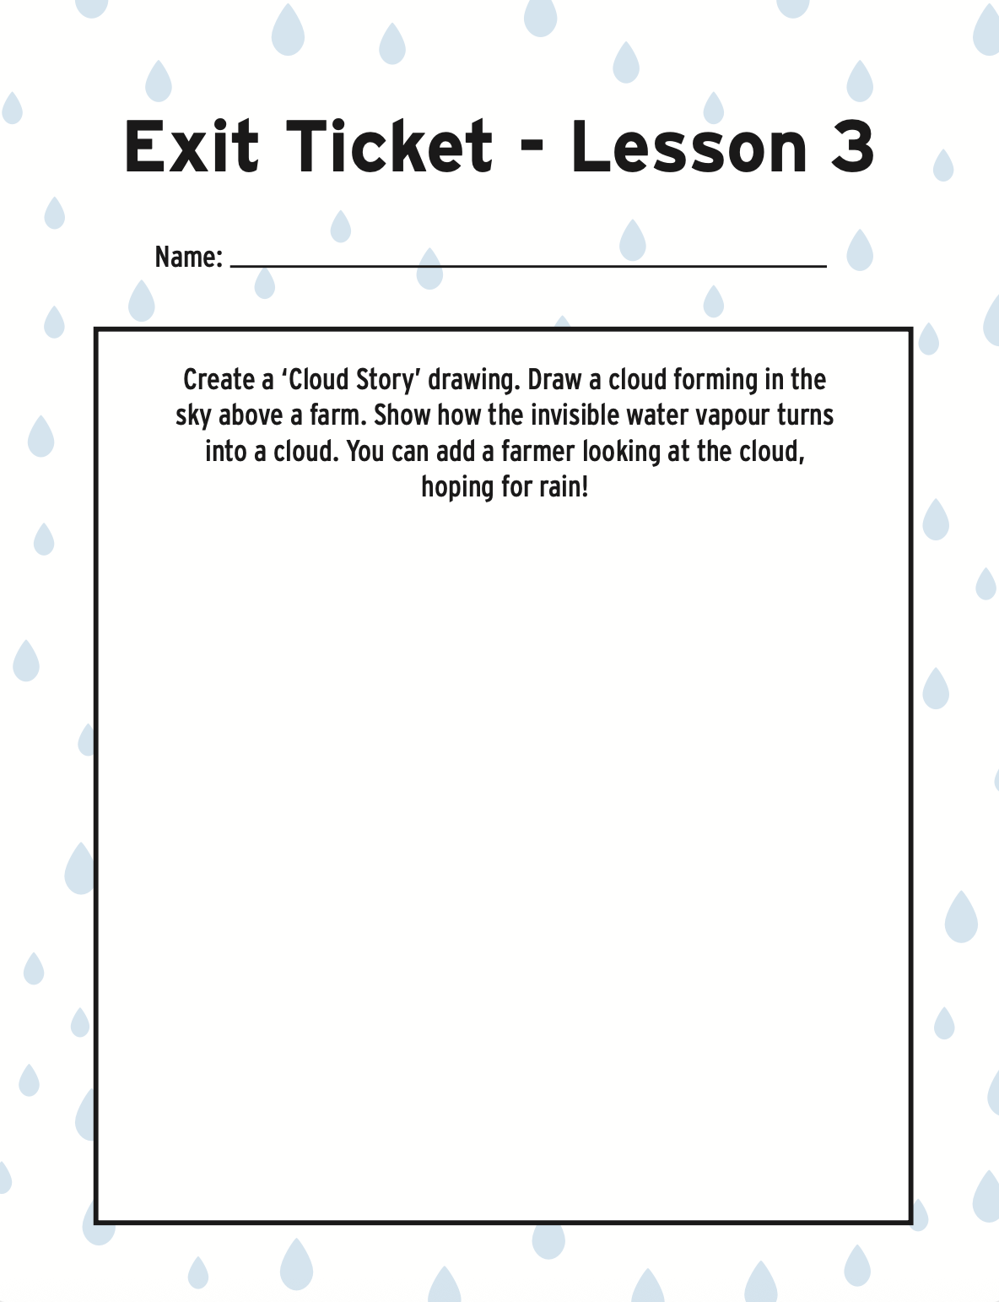
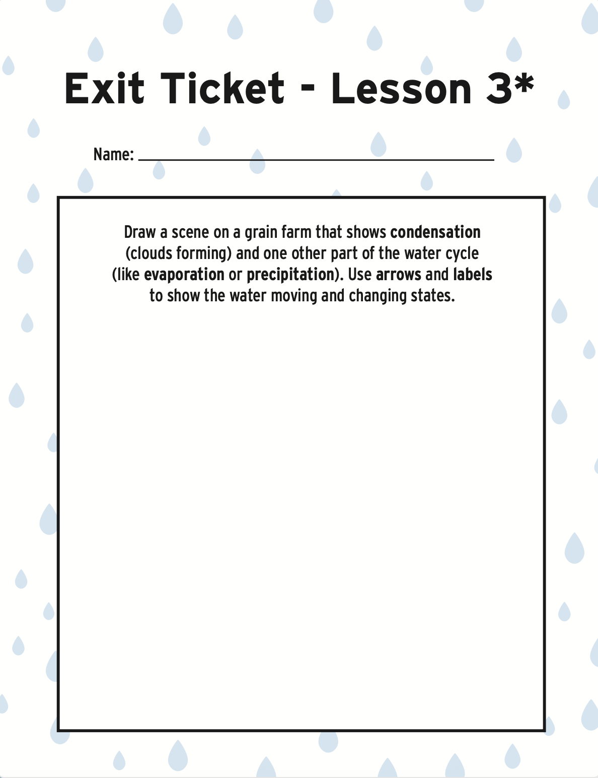
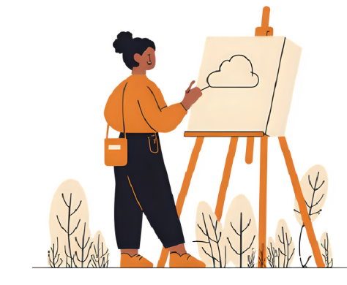
Show What You Know
Notes:
Educator Notes:
Have students create a 'Cloud Story' drawing. Draw a cloud forming in the sky above a farm. Show how the invisible water vapour turns into a cloud. You can add a farmer looking at the cloud, hoping for rain! The image is linked or click here to access they exit ticket.
Use the provided Lesson 3 exit ticket (can be downloaded from https://goodineverygrain.ca/2026/01/06/water-on-farms-a-six-lesson-unit-for-grade-2/) or have students record their answers in their notebooks, on a sticky note, or on a piece of paper.
Advanced Option (Marked on Lesson 3 exit ticket with a *): Have students create a 'Water Cycle Story on the Farm' drawing. Draw a scene on a grain farm that shows condensation (clouds forming) and one other part of the water cycle (like evaporation or precipitation). Use arrows and labels to show the water moving and changing states. Educators might encourage students to add a farmer in your drawing, thinking about the water!

